Slide 1
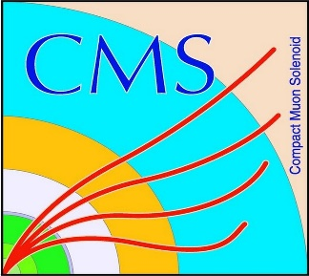

HEP Weekly Report
George Bakas
NTUA

Slide 2
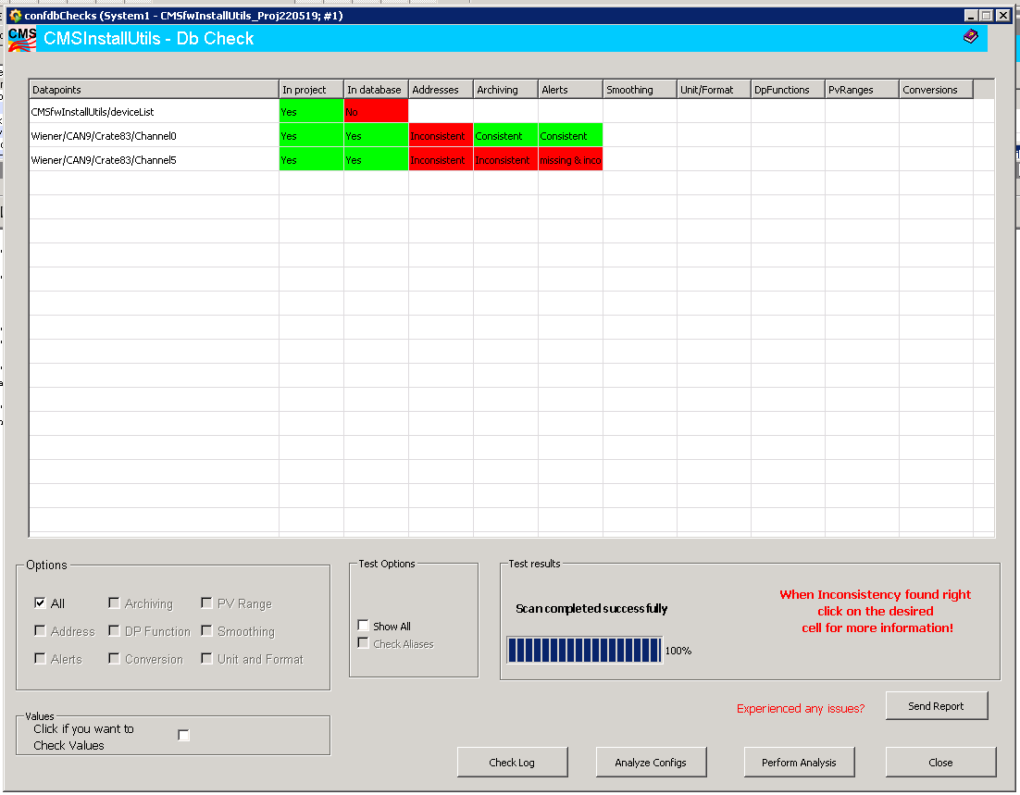
Progress Report
DCS
CmsFwInstallUtils
Found a way to show the user where the inconsistencies are in case the tool doesn’t find the inconsistency correctly
Report button so that when a user finds a new problem with the tool he/she can send an email directly to the developers of the tool

Slide 3
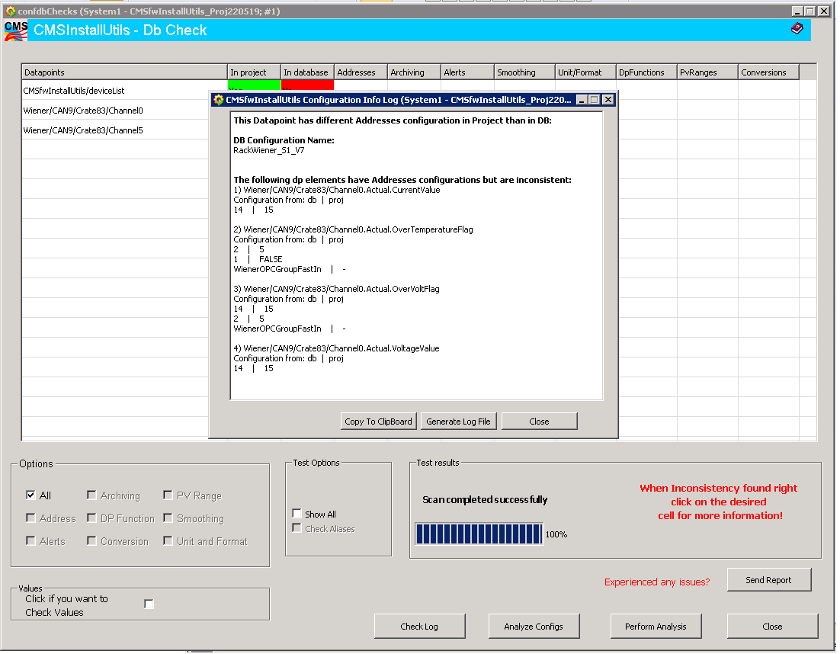
Progress Report
Now the user can see the exact inconsistencies between project and database for each datapoint element that has inconsistencies

Slide 4
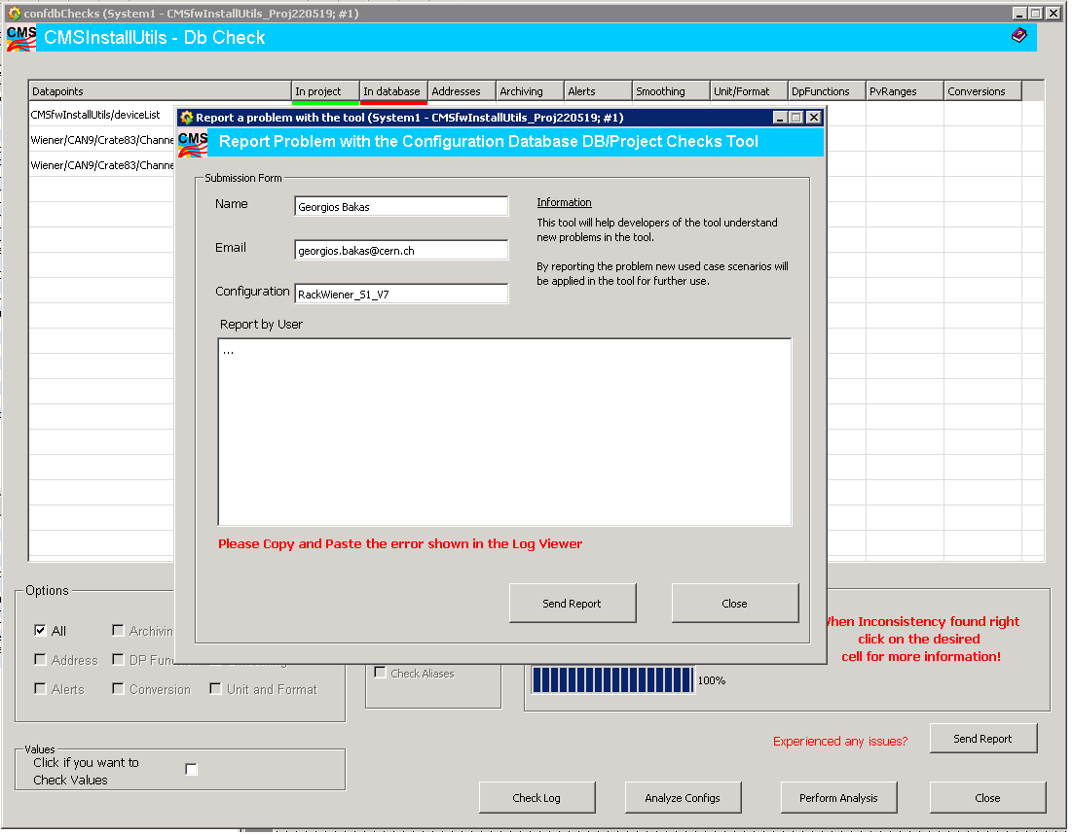
Progress Report
Here the user writes the issue
that he/she experienced

Slide 5
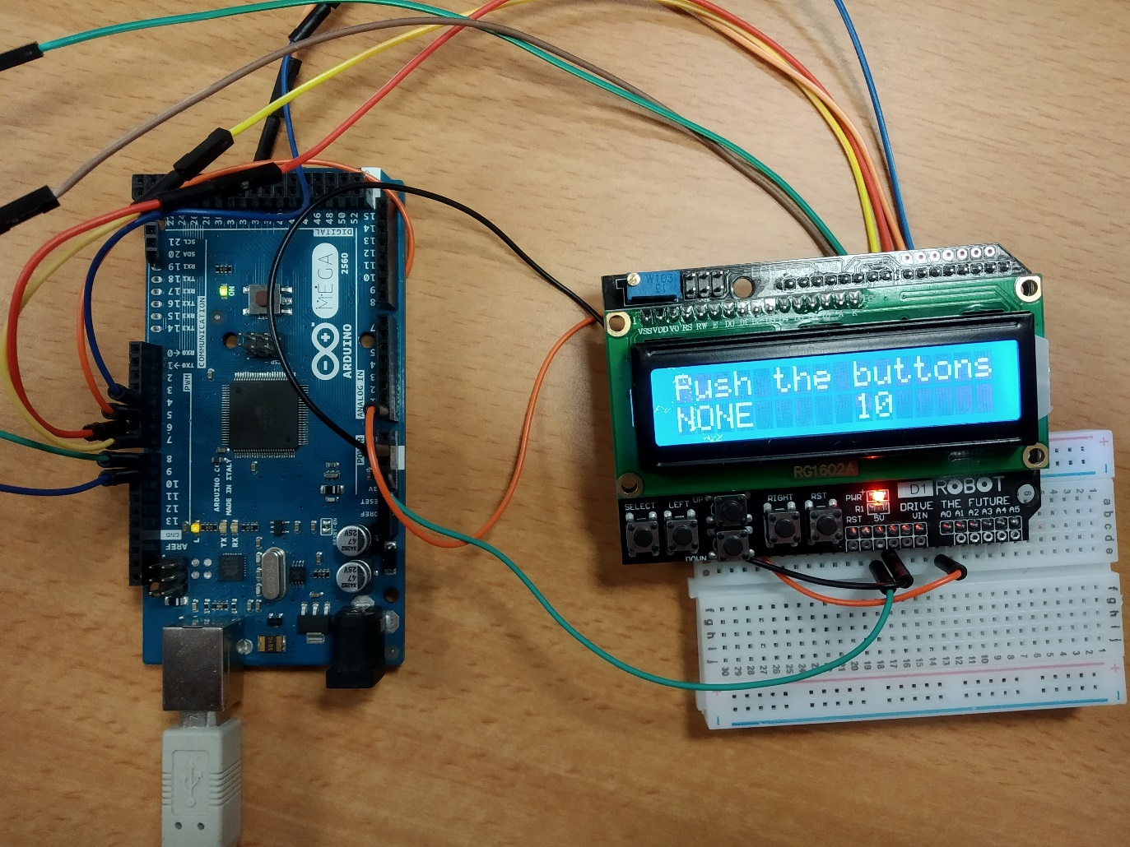
Progress Report
ArdEnvino
New screen works without having to be plugged on top of Arduino
Integration to the ArdEnvino schematic?

Slide 6
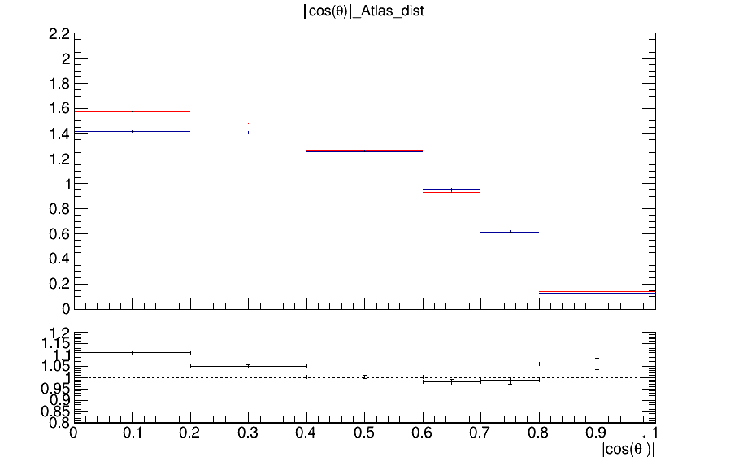
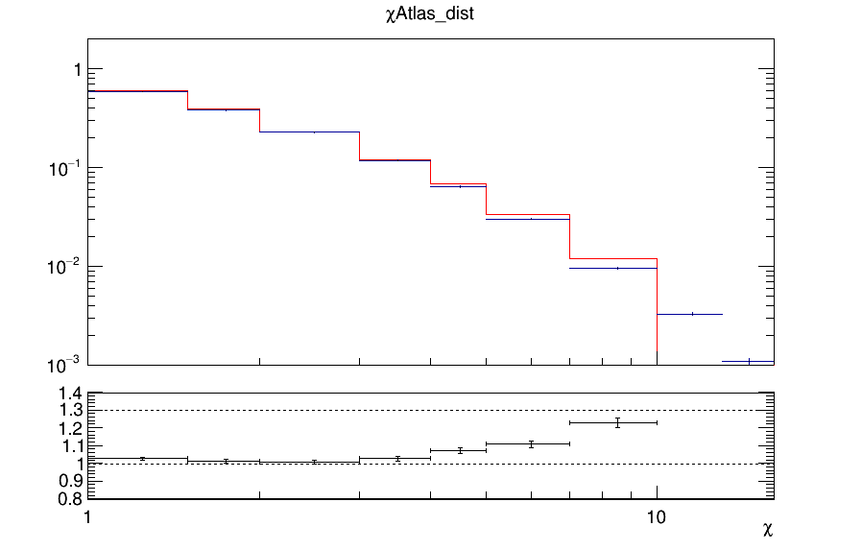
Progress Report
Analysis
Top cross section status report presentation
Production with DeepCSV scores for btagging
Both 2016 and 2017 MC
Same procedure with 2017 MC (efficiencies, acceptance, QCD closure, TT contamination etc)
Angular distributions→ comparisons with ATLAS results
cosTheta ATLAS
χ ATLAS
cosTheta CMS
χ CMS

Slide 7
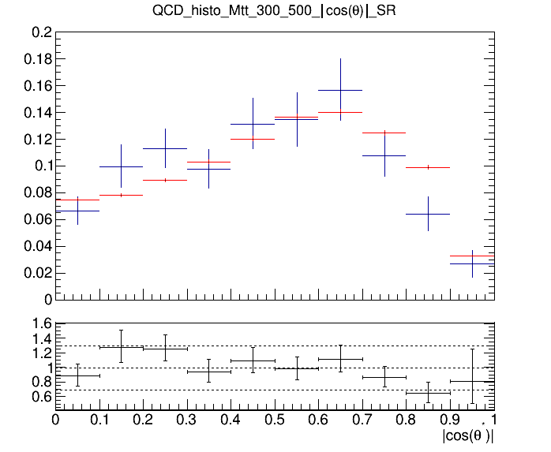
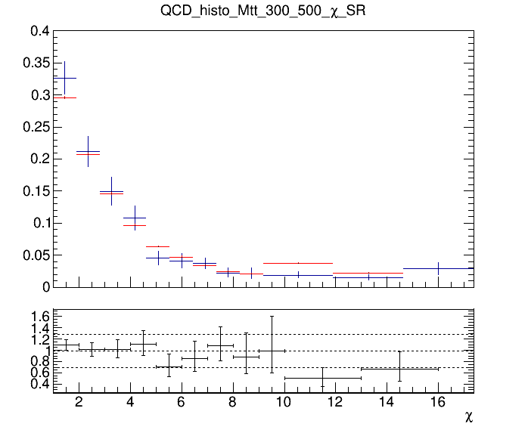
QCD Background MC closure tests
Closure test for QCD samples in Control Region (SR but btagging is reverted (btag==0))
topTagger Cut > 0.1
Control Region (0-btag)
Control Region (0-btag)
Signal Region (2-btag)
Signal Region (2-btag)

Slide 8
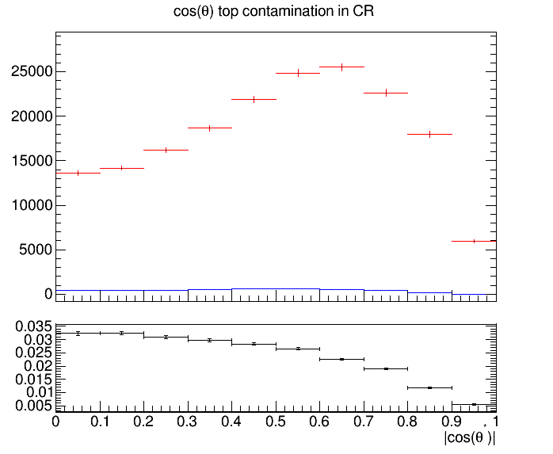
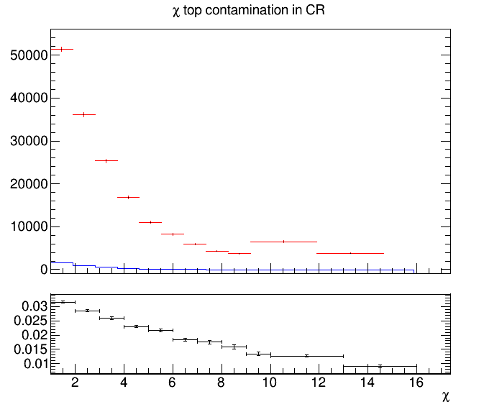
Control Region Contamination
Expected yield from QCD Bkg samples and TT Signal sample in the CR
topTagger Cut > 0.1
Control Region QCD sample
Control Region TT sample
Control Region QCD sample
Control Region TT sample

